Slide 1
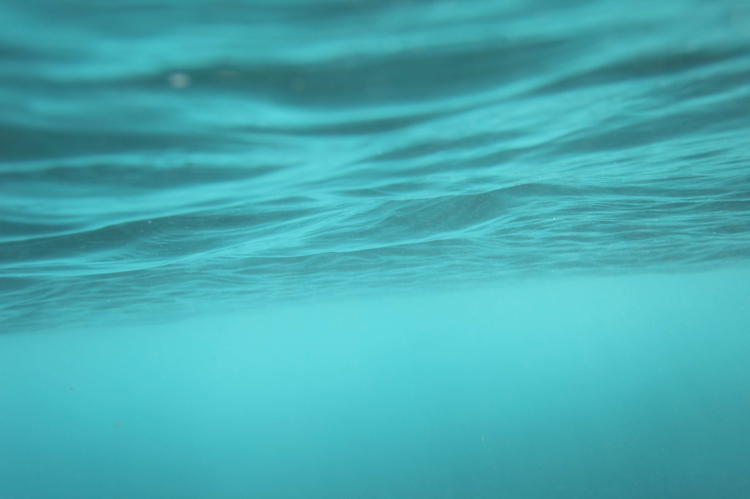
Dinghy restoration
Tom Lewis dinghy project 2022

Slide 2
Introduction
This is a PowerPoint to show my recently completed project that I am proud to share with you. I enjoyed every step of the project and overcame many obstacles that became apparent to me through my experience. I feel like I took great amounts of pride during my dinghy restoration and I am extremely happy to be sharing my work with you.

Slide 3
First Insights
This was the dinghy that my employer wanted me to restore because he felt like it would be a great learning curve and a perfect project to widen my skill set and to learn different techniques that I may not have had the opportunity to explore.

Slide 4
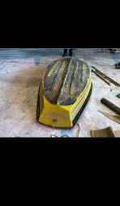
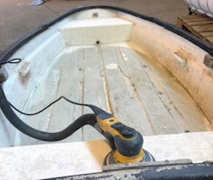

Slide 5
Stepping stones
the first step of my project was to dismantle all fittings in the interior of the dinghy so that work could be done with efficiency along with a complete fresh start to start off with. After that I began removing all the antifoul from the hull this needed to be done as the paintwork needed a complete refurbishment due to neglect and poor maintenance. I began the sanding process with vigour. Once sanded and cleaned up I applied my first coat of paint which was an epoxy paint. I then applied an underwater primer once the epoxy had fully cured for added protection and durability.

Slide 6
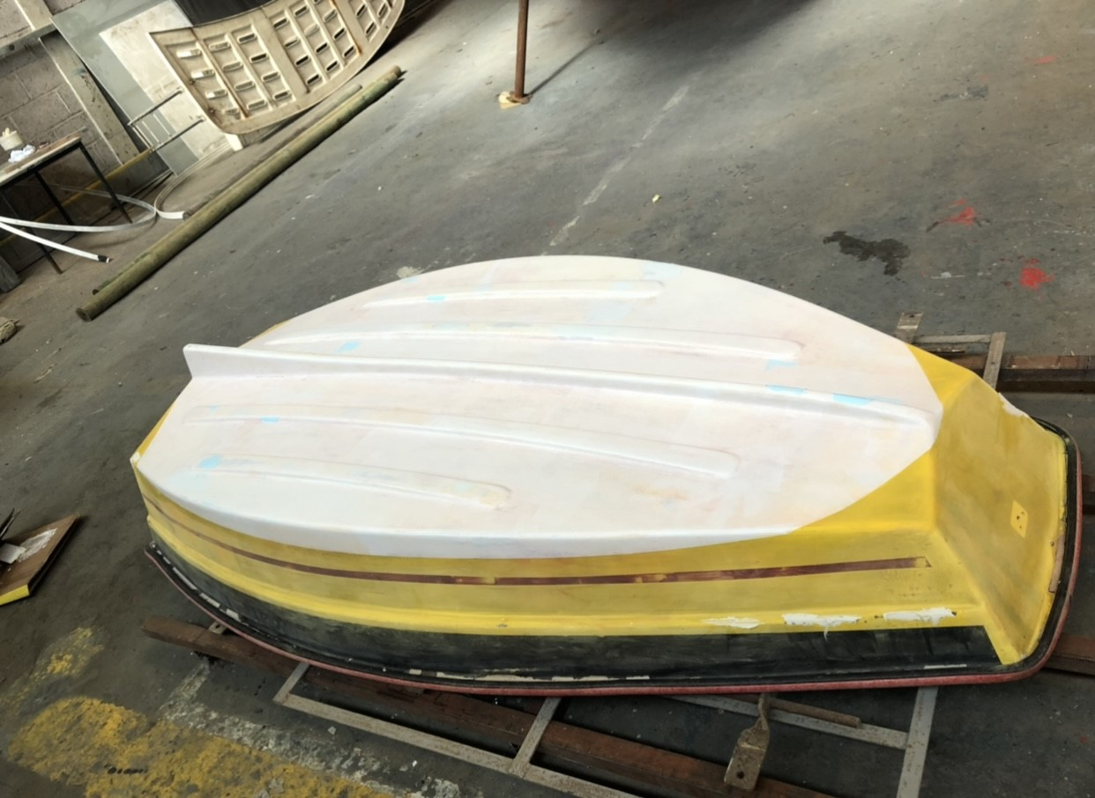
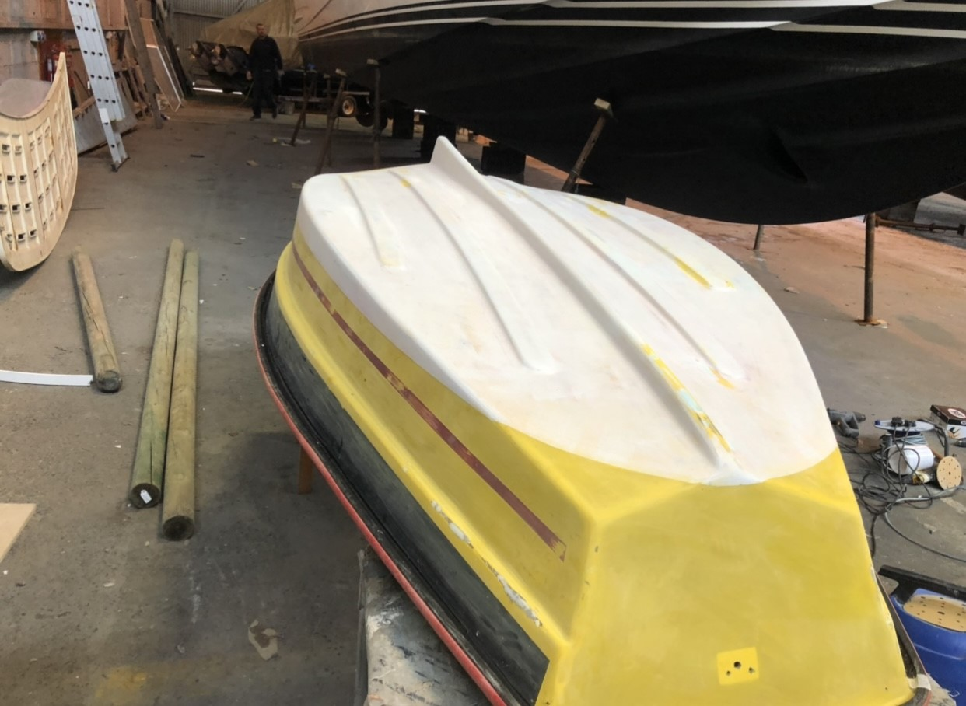

Slide 7
Next steps
The next step I began was the paintwork on the outer hull which was also in bad shape. Once the sanding was completed I applied epoxy filler in all the cracks, scratches and dips so that once painted it would have a nice tidy finish and to the correct standard that I am expected of. I then sanded the filler and applied three coats of build primer. Once the primer had cured I used a blacking technique which helps when sanding build coat to avoid fish eyes in the paintwork. if the sanding of the build coat is done poorly it shows on the last coat of paint so preparation is key.

Slide 8
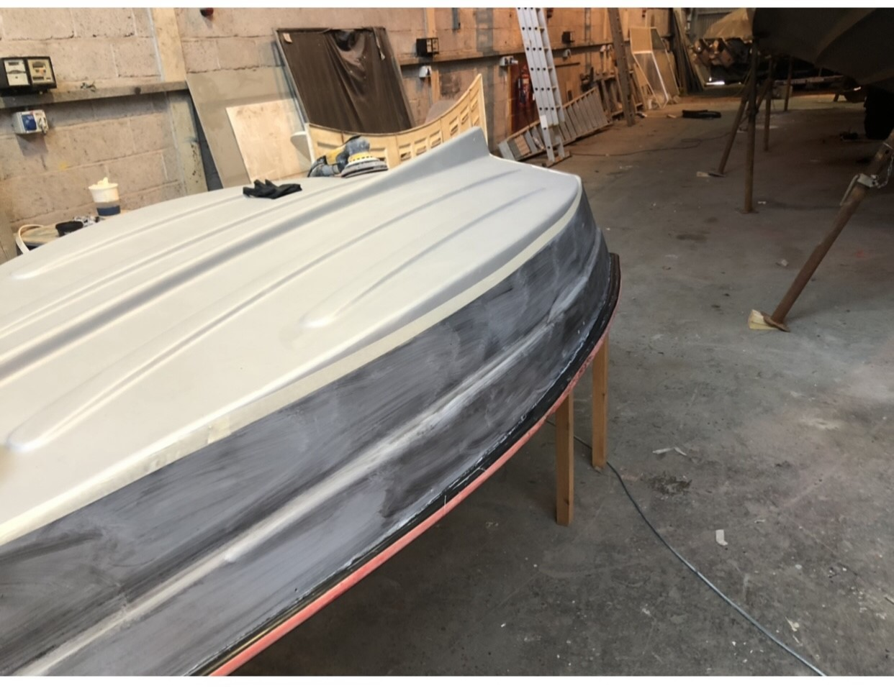
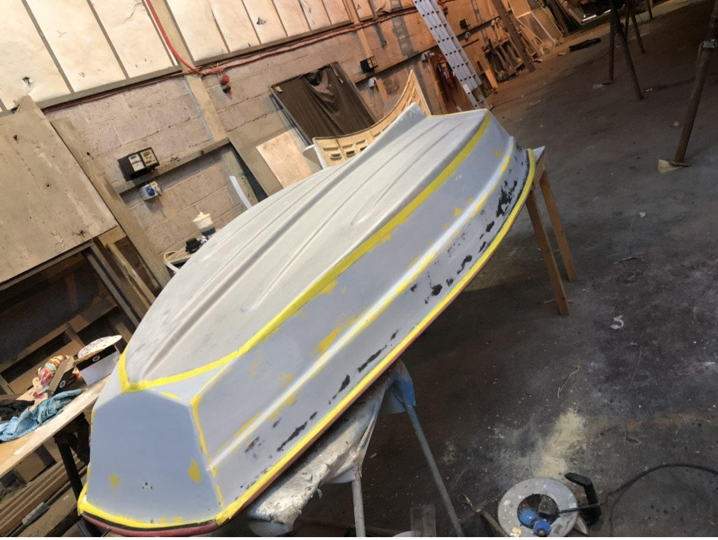
Before sanding
After sanding
During the sanding of the build coat I had a few minor cut throughs of the build coat. I realised after that I may could’ve put a extra coat of build primer to prevent cutting through as easy, so next time I now know that an extra coat could improve my quality of work .

Slide 9
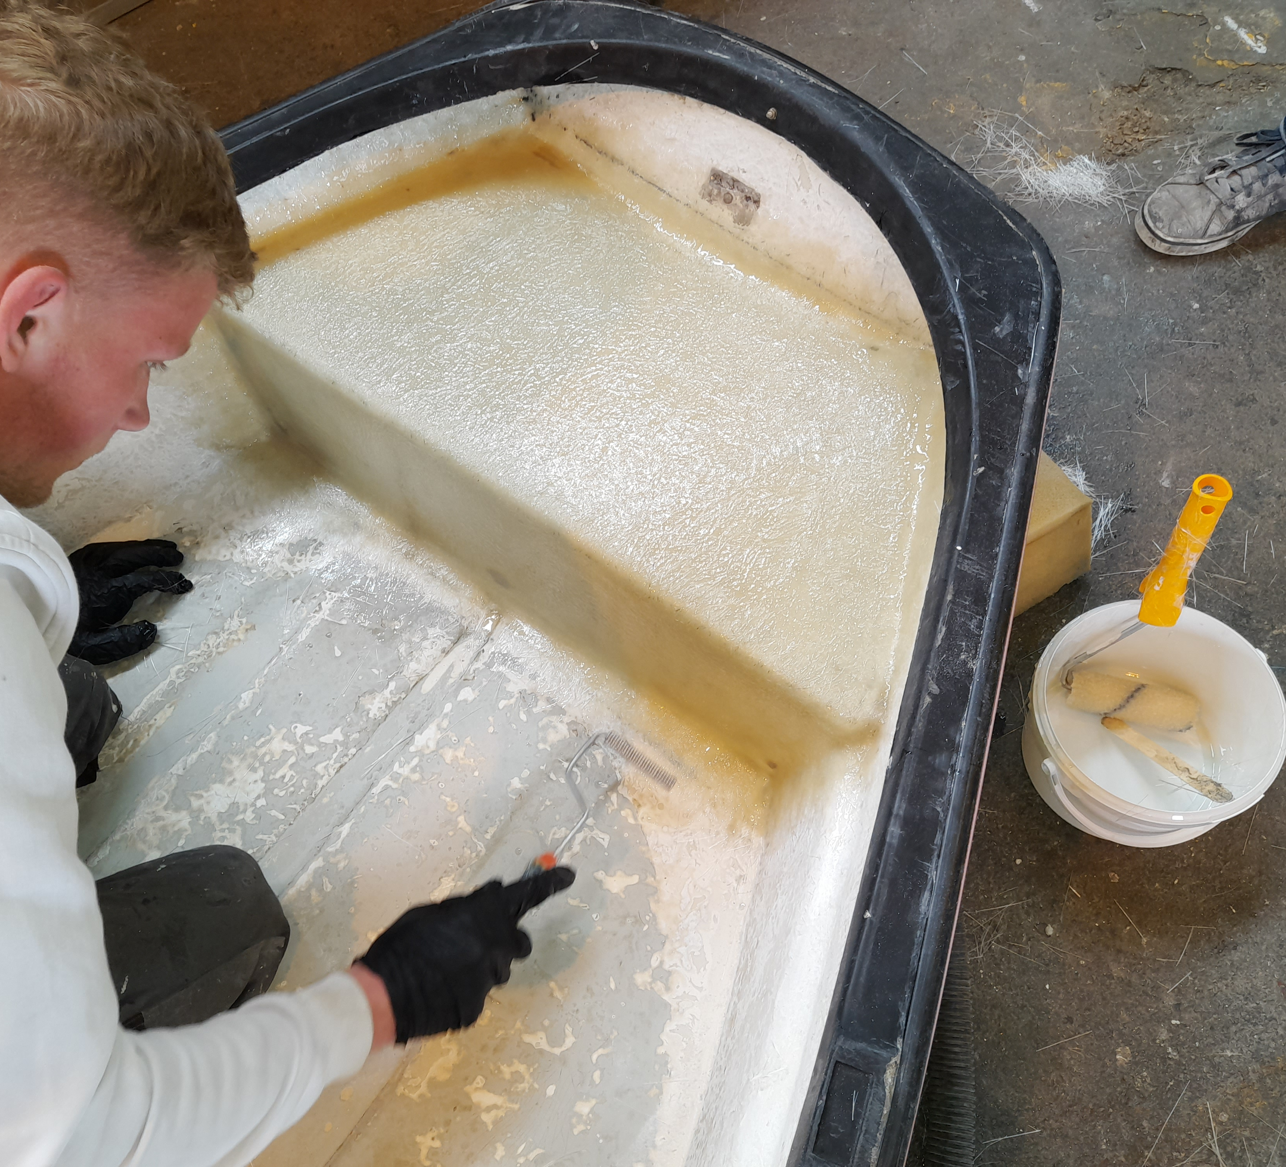
Fibre glass repair
A fibre glass repair needed to be done as the seating area of the dinghy was cracked right through the fibreglass leaving multiple small holes in the laminate which needed attention.

Slide 10
Interior work and Final coats of paint using the roll and tip technique
interior
To start the interior work I began with a heavy sand to feather in and remove any loose paint. This helps when it comes to applying paint so that you get a good bond. I decided to apply white gel coat as I thought this would be the best solution for the interior of my project and would ensure a durable and a finish I would be happy with.
I also applied black gel coat on the rub rail which gave an appealing finish I was happy with.
Exterior
Prior to painting I had no experience with the roll and tip technique so I was eager to start painting. My work colleague helped apply the first coat of paint so that i had a better understanding of how to successfully apply the paint which I was thankful for. I then applied a further two coats of single pack paint with no assistance.

Slide 11
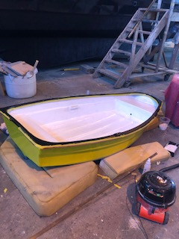
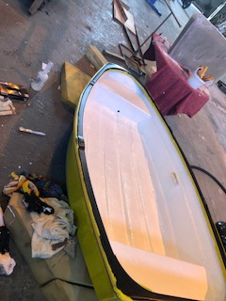

Slide 12
Woodwork and antifoul
With help from my work colleague we began the woodwork which was wooden slats that added reinforcement on the hull to protect the antifoul and fibre glass we used the old slats as a template for our new slats and began measuring and cutting of our woodwork which we decided to use iroko. We then countersunk and pilot holed so that the new screws for the woodwork could be screwed in with no problems. I ensured I applied sealant to prevent corrosion on the screws and rotting of the wood. Woodwork is an area i have a lot to improve on. Woodwork takes a lot of time and experience to master.
before I fitted the woodwork I applied two final coats of antifoul on the hull for added protection against sea life.

Slide 13
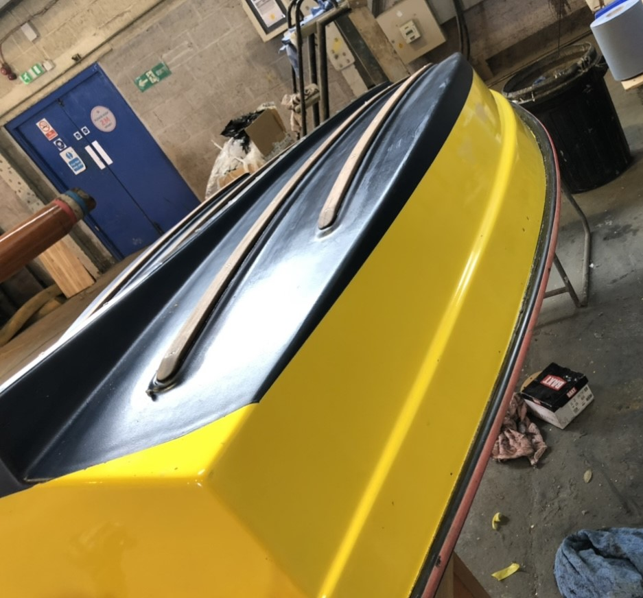
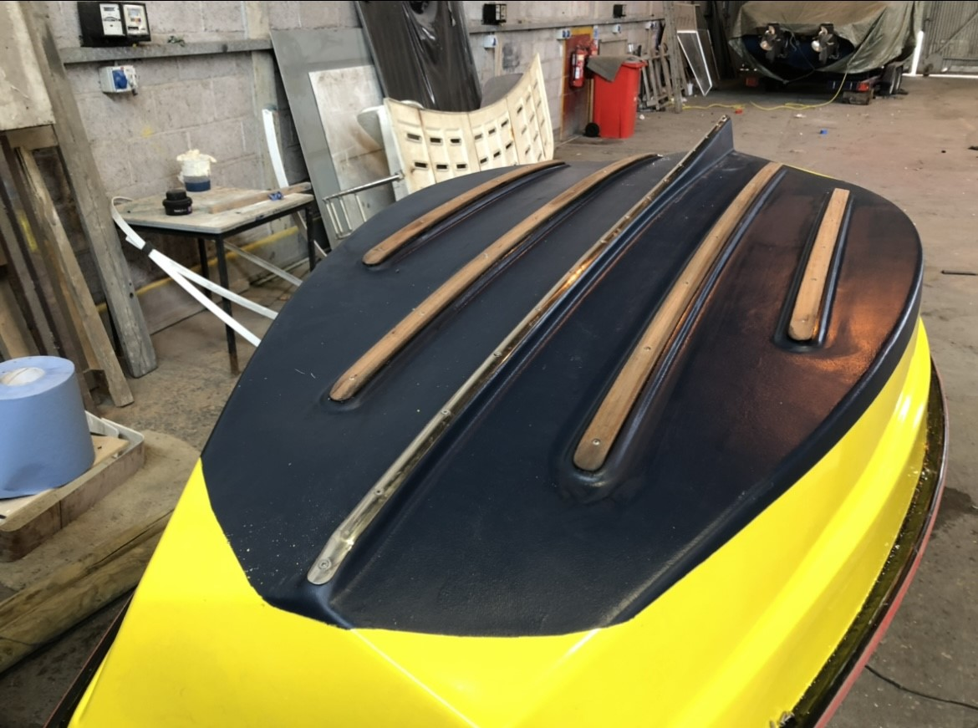
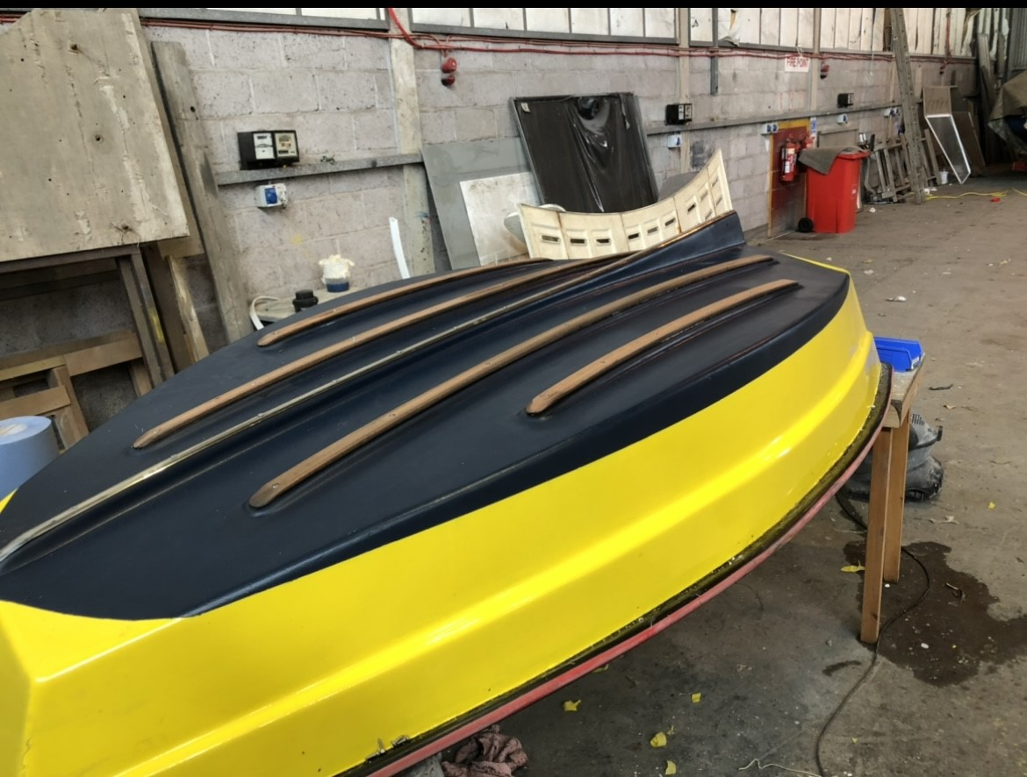

Slide 14
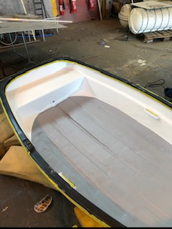
Final interior detailing (flow coat)
I applied a final coat of flow coat to enhance the appearance which then gave a more appealing look. Masking up was a small issue I had to overcome because it needed to be a nice and accurate tape line to match the curve of the interior.

Slide 15
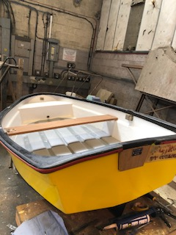
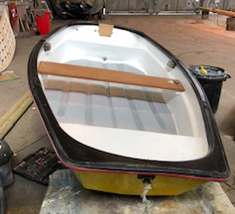
Re-assembly of all fittings and final snags
Once all the repairs where done I ensured all the fastenings where sealed and everything was put back on the dinghy in the correct manor.
My employer was extremely happy with the outcome of my project and was full of praise.

